Slide 1
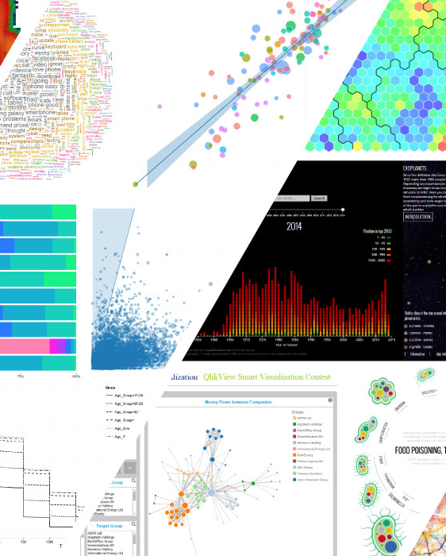
Data Visualisation Project
Newton Long 15/02/2024

Slide 2
Contents
Project Overview #
Desired Outcomes #
Solution Process #
Demo #
Final Thoughts #

Slide 3

Project Overview
Context, purpose and outline of the data visualisation project

Slide 4


Project Outline
What is this project about?
For what purpose?
Creating visualisation tools
Innovate our data visualisations and analytics
“Funky” visualisations for diverse ways to see data
Extrapolate fresh insights from internal and external stakeholders
Utilise public & internal data to extract insights
Could be used for decision-making, strategic initiatives and biz operations

Slide 5



Proposed Outcomes
Dashboard Creation
Create a dashboard to showcase visualisations and have interactive user experience.
Enhanced visual communication
Innovative data vis, help interpretation of events.
Establish Partnership With Analytics Vendor
Get proof of concept for what is possible, then connect with data analytics service

Slide 6

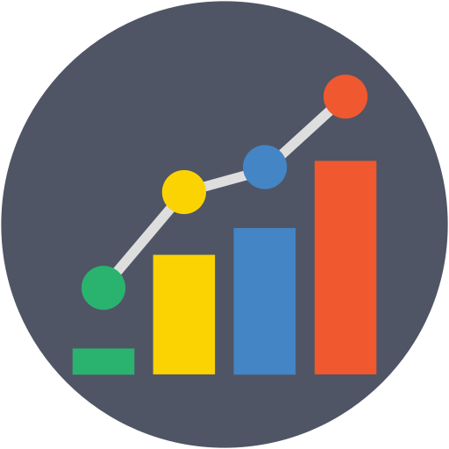


Solution Plan
Step 01
Step 02
Step 03
Step 04
Create a medium to deliver the visualisation tools.
Analyse and conjure visualisations from public and given data.
Combining visualisations into an interactive, all encompassing medium.
Present and showcase final product

Slide 7
Medium Selection
Web Application?
Optimal for Project?
Difficulty?
Can be accessed easier, use basic web dev or python library
Yes, simple design capabilities, and very suitable in showcasing visualisations.
Moderate, can bypass lower-level web development code (HTML, JS & CSS) using python library, to focus on delivering visualisations than website.
Desktop Application?
Optimal for Project?
Difficulty?
Use tkinter, for basic desktop application
Not exactly, possibly for future yes, but for purpose of generating proof of concept visualisations web application would be better suited.
Moderately hard, requires complex software design, interactivity and understanding of tkinter.

Slide 8
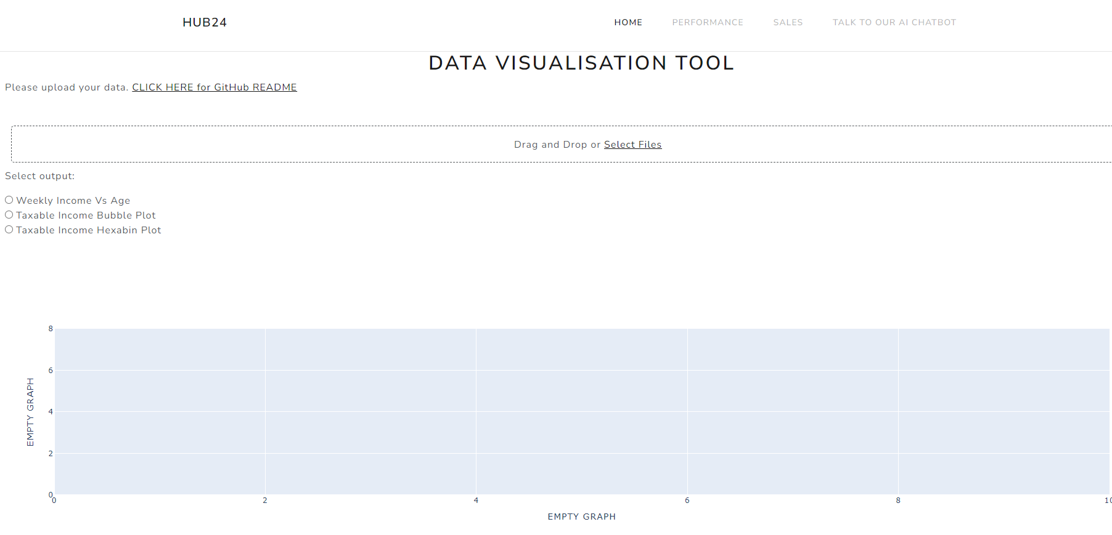
Website Layout Design
For a tool that focuses data visualisations, a simplistic design would be best
Avoid fancy all over the place designs
Provide insightful visualisations, easy to understand and clear
-----------------------------------------------------------
Navbar
Upload section
Visualisation specifier
Visual output

Slide 9
Obtaining data and creating outputs (1st page)
What data is available?
How could the data be visualised?
Data obtained was:
Income vs age groups
Average taxable income across Australian postcodes
Incomes vs postcode in Sydney (dummy data)
-----------------------------------------------------------
Bubble plot
Geographical bubble plot
Hexabin plot

Slide 10
Tracking Investor Performance (2nd page)
Benchmarking feature to compare different accounts and their results?
Performance summarisation feature?
Analysing anonymized data
Line graph representation?

Slide 11
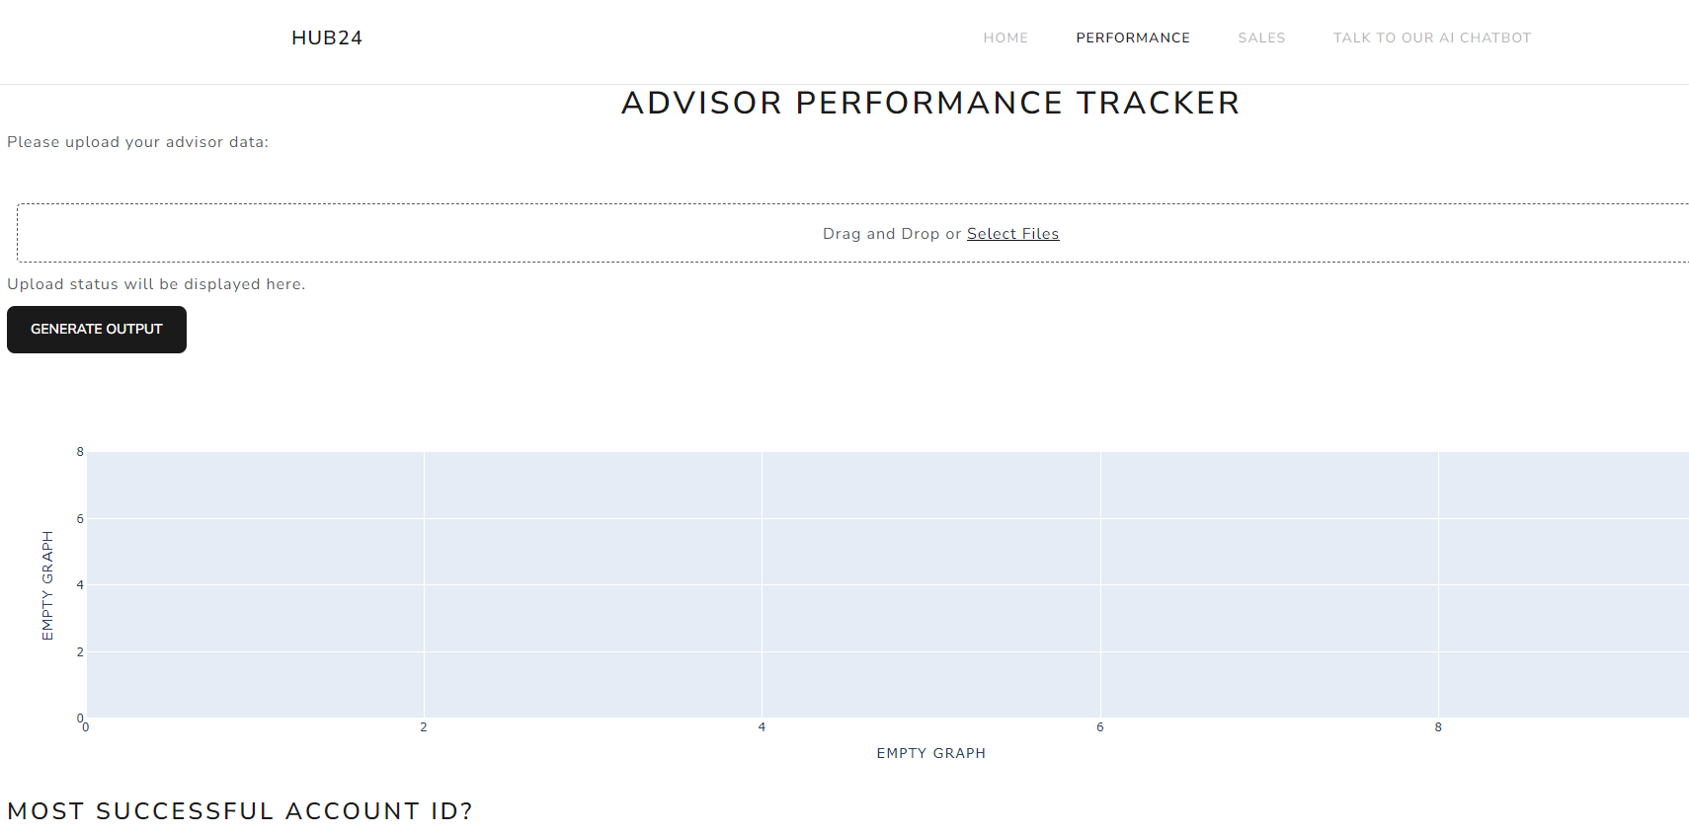
2ND Page

Slide 12
Sales page & asset portfolio visualisations (3rd Page)
A page dedicated to sales visualisations
Also containing asset portfolio representations
Provide valuable insights to advisors / clients alike

Slide 13
AI Chatbot integration (4th Page)
AI has revolutionised technology and business, and will only further create more opportunities in the future
Integrating a chatbot feature would greatly reduce the need for in person assistance, and have a tool that can explain and elaborate visualisations on the website
Automating the process of creating visualisations based on simple prompt
24 hr assistance
Scalable
Cost reduction
With many more other benefits

Slide 14
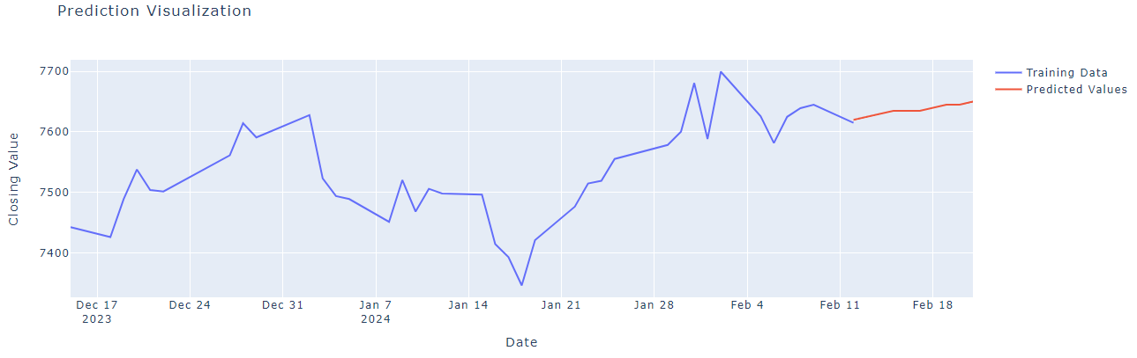
ASX200 Forecasting with Markov Chains
Takes prior 60 days of data
Calculates transition probabilities
Uses that to predict future days based on an arbitrary +- 5 AUD amount
Results:

Slide 15
Bitcoin Digital Currency Forecasting -> ML Solution
Machine learning solutions are highly dependent on quality data
When working with lots of data, and training different models -> visualisations are a critical tool to gauging performance and effectiveness (without it very difficult to see progress or what is going on)
Machine learning solutions can be applied to quantitative trading algorithms and require visualisations to monitor and improve effectiveness
Separate fields – but combined renders a powerful tool
Proof of concept?
Forecasting bitcoin value…
Using historical prices…
Using which machine learning model?
-> Long Short-Term Memory model

Slide 16
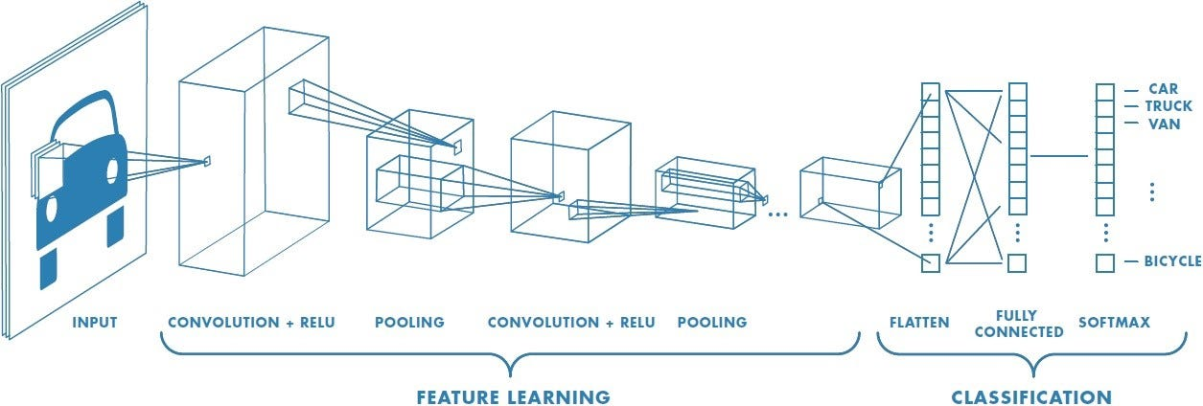
Why LSTM Model?
When creating a ML solution, selecting an appropriate model is important as some work better for different contexts:
ie computer vision tasks like facial recognition or distinguishing dogs from cats -> Convolutional Neural Networks:
Tasks that involve text:
-> Transformer models -> BERT
Bidirectional Encoder Representations from Transformers
(Halisok’s PDF classification uses this)
And other tasks that involve text data… like natural language processing etc

Slide 17
What to use for BTC forecasting?
When deciding on a model to use, LSTM model -> type of recurrent neural network, best suited for sequential data analysis.
ie -> time series data where chunks of data are dispersed over periods of time.
Capture long-term dependencies from sequential data…
Hence, a good model for predicting prices
Yahoo Finance
Trained LSTM model with dates from 2014 to 2016
Feeding 3-day chunks of data
Then having a validation period 80 – 90% of the time frame
Then test run from 90 – 100% of the time frame

Slide 18
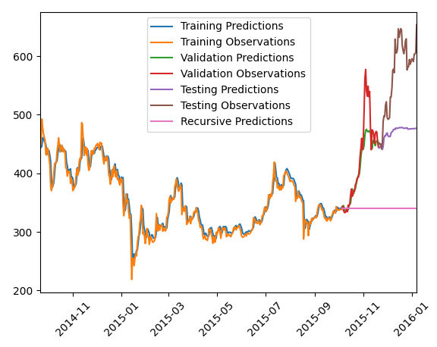
BTC Prediction Results
Reasonable results
Crypto typically quite volatile
Visualisation allows for performance auditing

Slide 19
Demo Time
Live demonstration

Slide 20
Final Thoughts
Future Improvements
Future Actions
Completing all functionality
Continual upgrades in quality of outputs
The way data is managed can be transitioned into more advanced data base system, like MongoDB, PostgreSQL and Neo4j.
(heavier storage abilities and thus more advanced applications)
Partner with qualified vendor
Give details of what is needed (data cleansing etc)
Outsource heavy loading
Invest in machine learning solutions (like we currently do with Halisok)

Slide 21
Personal Takeaways
Experiences
Work Environment
Collaboration with Gov and Josh, being able to share ideas and give feedback
Client focus, being able to see the full-time horizon of this project, gave more specifics on how can we make this best for the end users
Integrity – following the projects outlines and keeping it consistent with what was aimed for
Great work environment, good for learning and working with others
Expanding on skills developed and exploring new fields like data analytics + visualisation and doing it in python

Slide 22
Thank you!
This is the end of the presentation.

